Slide 1
AI-Resume Screening & Candidate Matching
A.Veena(23R11A6799)
B.Srinidhi(23R11A67A6)
G.Hasini(23R11A67B4)

Slide 2
Problem Statement
Manual resume screening is time-consuming, biased, and error-prone.
Recruiters face high application volumes and inconsistent evaluations.
Need for automation and intelligent candidate-job matching.

Slide 3
Project Objectives
Automate resume parsing and candidate filtering.
Match resumes to job descriptions using AI.
Reduce human bias and increase efficiency.
Create a scalable and user-friendly solution for HR teams.

Slide 4
Technologies Used
Frontend: HTML/CSS or ReactJS.
Backend: Python with Flask .
NLP: spaCy, NLTK, Transformers (BERT).

Slide 5
Resume Parsing
Converts unstructured resume text into structured data.
Extracts: Skills, Education.

Slide 6
Job Description Analysis
Extracts key skills and requirements using NLP.
NER and key phrase extraction from job descriptions.
Matches the resume according to the requirments.

Slide 7
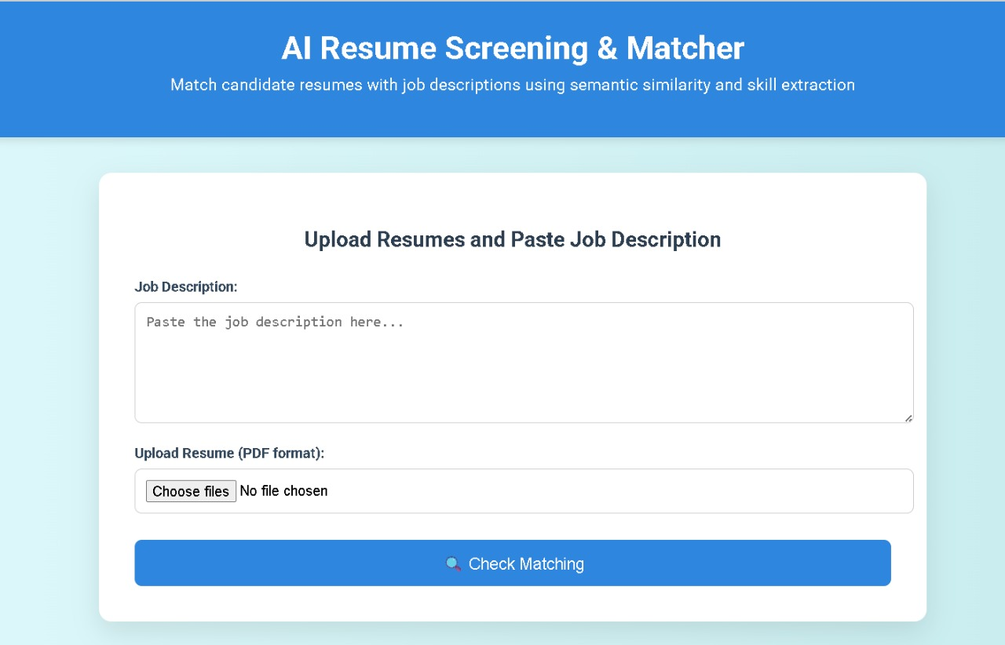
Demo Screenshots

Slide 8
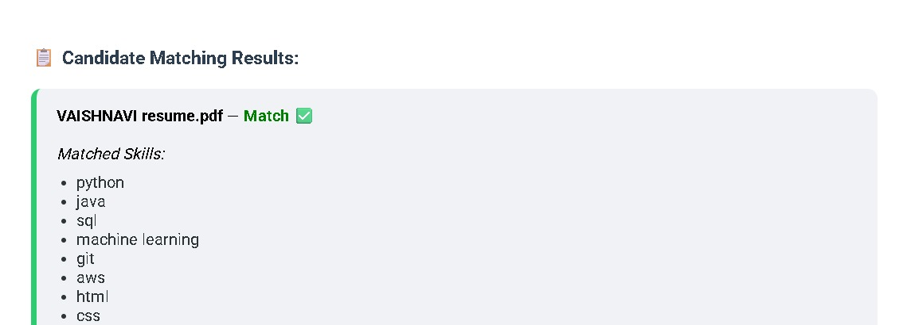
OUTPUT

Slide 9
Results & Evaluation
Time saved vs. manual screening.
Reduced manual work.
Improved candidate shortlist quality.

Slide 10
Challenges Faced
Inconsistent resume formats.
Ambiguity in job descriptions.
Tuning models for different industries.
Privacy and data sensitivity.

Slide 11
Future Scope
Support for multilingual resumes.
Live feedback for candidates during application.
API integration with job boards, LinkedIn.
Explainable AI for transparency in ranking.
Role based recommendation engine.

Slide 12
Conclusion
Successfully developed AI-based screening and matching system.
Improves hiring efficiency and fairness.
Enhances recruiter decision-making with intelligent recommendations.
Reduces manual work .

Slide 13


